Slide 1



Predicting Customer Purchase Behavior
Understanding customer purchase patterns using machine learning.
by Akash Gade
AG

Slide 2

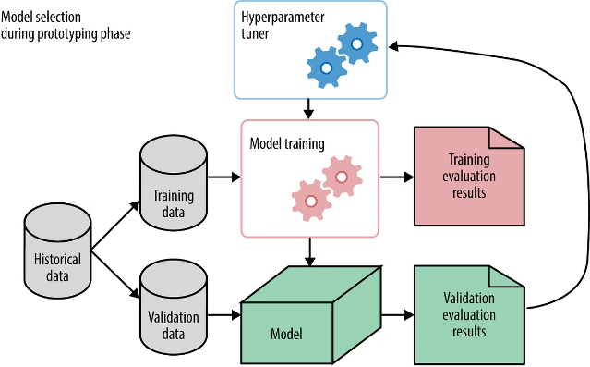
Project Overview
1
Objective
To develop a Machine Learning Model that can predict whether
a customer will make a purchase or not.
To use this model to enhance marketing strategies, improve
customer targeting and boost sales.
2
Dataset
Data is imported using Pandas library. It has 1,500 records with 9 features.
3
Data Cleaning
Removed duplicates, checked for missing values.
Used Feature engineering to create "Time Spending Efficiency.

Slide 3
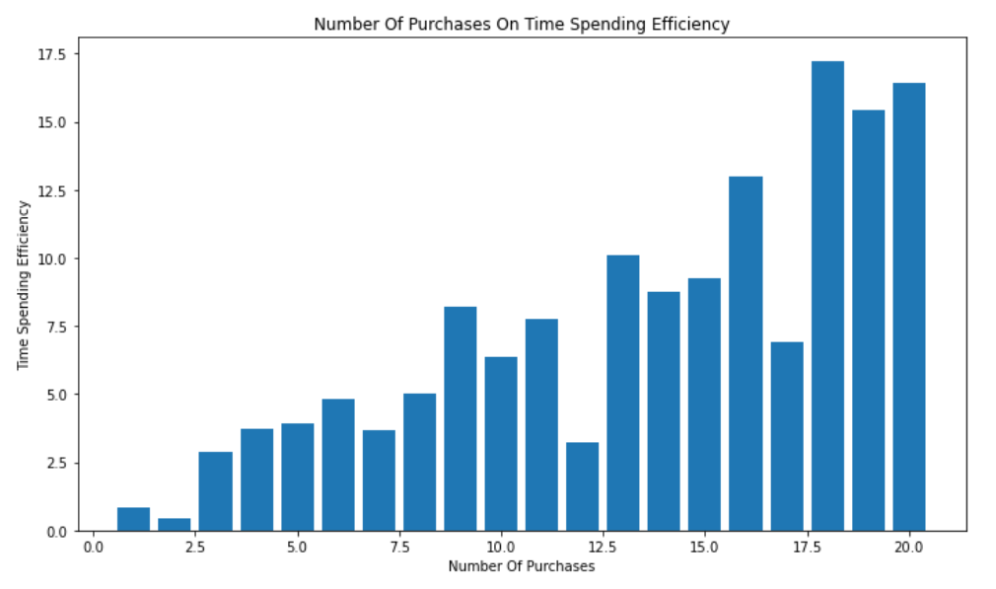
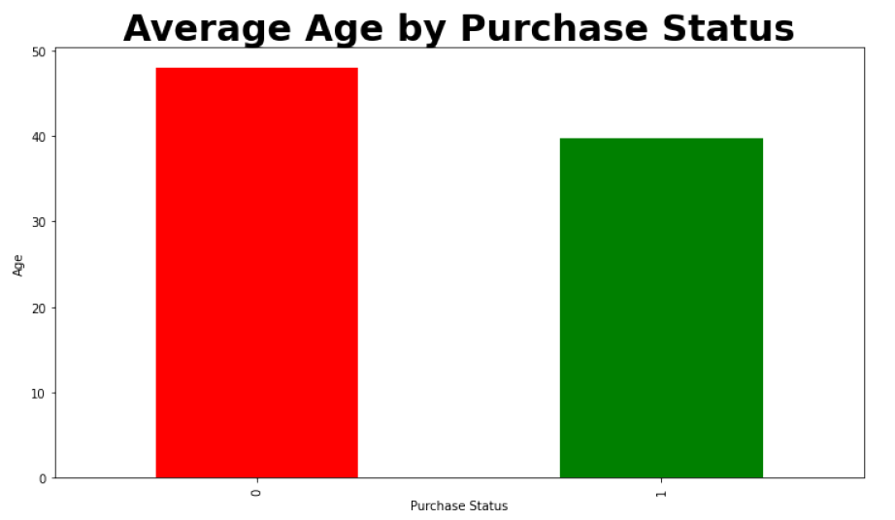
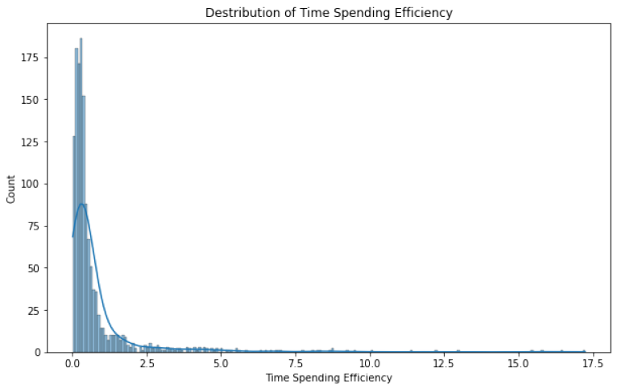
Exploratory Data Analysis
Understand key insights from data.
Number Of Purchases On
Time Spending Efficiency
Avg Age by Purchase Status
Time Spending Efficiency
Number of purchases increases with time spending efficiency.
On an average young people purchase more as compared with old people.
The data is skewed towards left. The majority
of observations have low time-spending
efficiency.

Slide 4
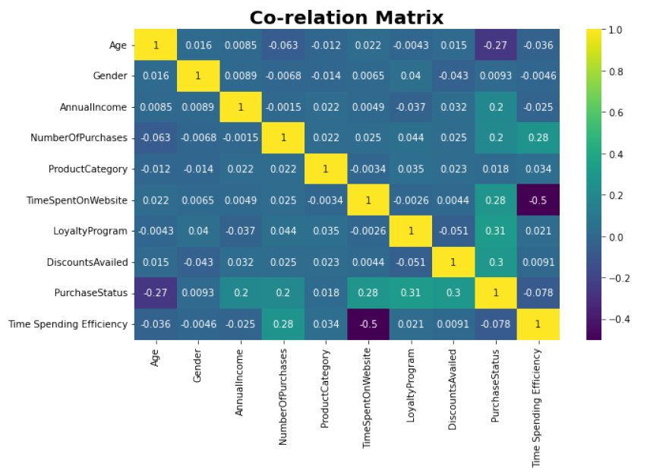
Correlation Analysis
Key Findings
significant correlations between features like Time
Spent on Website and Purchase Status.
Weak correlation between Age and Purchase Status.
More discount leads to significant Purchase Status.
Loyal customers have a higher likelihood of
making a purchase.
Heatmap Visualization
Displays correlation coefficients among features.

Slide 5


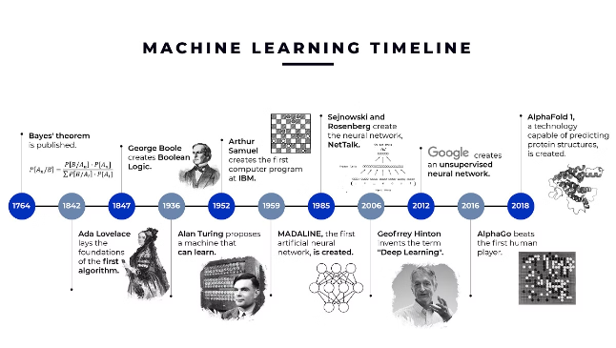
Model Selection
Logistic Regression
A simple and interpretable model.
Support Vector Classifier
2
Classifies data by finding an optimal line or hyperplane .
K-Nearest Neighbors
3
Based on similarity to past data points.
Random Forest Classifier
4
Ensemble learning for improved accuracy.

Slide 6

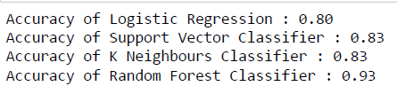
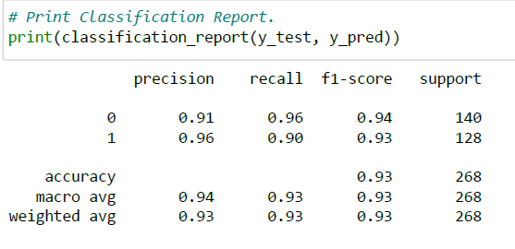
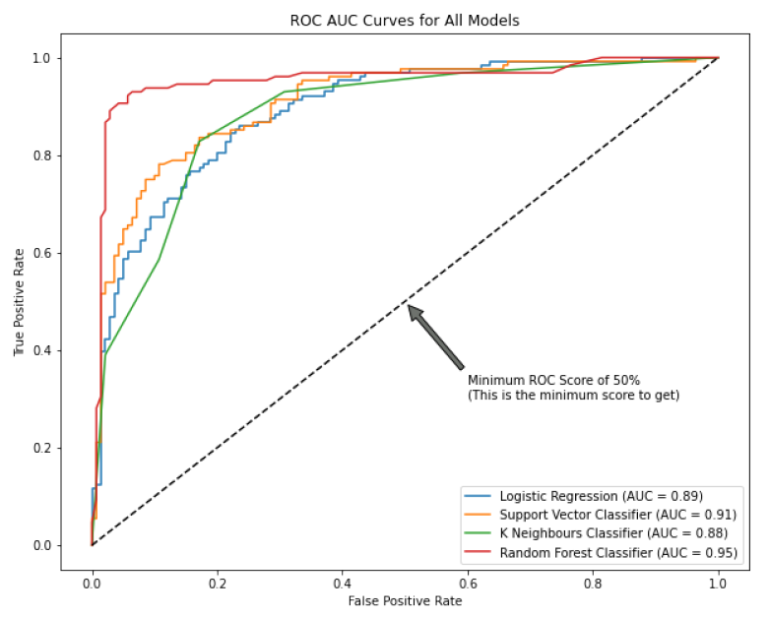
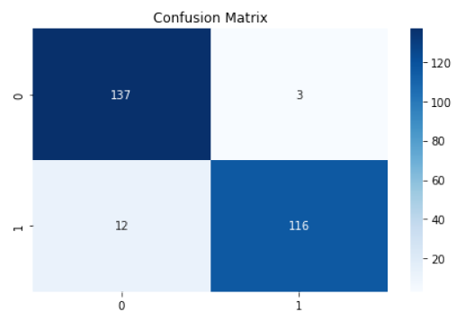
Model Evaluation
Evaluate performance using various metrics.
Accuracy
Overall model correctness.
Classification Report
Provides insights into the model's performance across different classes.
Cross Validation
Dividing the data into multiple subsets or folds , then averaging the results
ROC-AUC
Measures model's ability to distinguish between classes.

Slide 7
Conclusion
Found that age groups 18-39 generally spend more time on the website and make more purchases
compared to older age groups.
Identified significant correlations between features like Time Spent on Website and Purchase Status.
Time Spent on Website is a strong predictor of purchase behavior.
Loyal customers and those availing discounts have a higher likelihood of making a purchase.
Business Recommendations:
Target marketing efforts towards the 18-39 age group.
Make new strategies to target age group above 40.
Enhance website engagement strategies to increase time spent on the site.
Offer more discounts and loyalty incentives to boost purchase rates.

Slide 8
THANK YOU

